Slide 1
Node.js

Slide 2
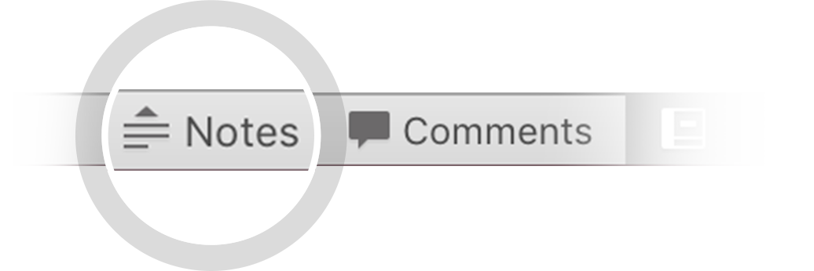

Here's your outline to get started
Key facts about your topic
Node.js is an open-source, cross-platform JavaScript run-time environment that executes JavaScript code outside of a browser. Typically, JavaScript is used primarily for client-side scripting, in which scripts written in JavaScript are embedded in a webpage's HTML and run client-side by a JavaScript engine in the user's web browser. Node.js lets developers use JavaScript to write Command Line tools and for server-side scripting—running scripts server-side to produce dynamic web page content before the page is sent to the user's web browser. Consequently, Node.js represents a "JavaScr...
Developer: Joyent
Written in: C, C++, JavaScript
Stable release: 11.1.0 / November 2, 2018, 6 days ago
License: MIT license
See more: Open the Notes below for more information.
Notes:
QuickStarter has created an outline to help you get started on your presentation. Some slides include information here in the notes to provide additional topics for you to research.
Summary:
Node.js is an open-source, cross-platform JavaScript run-time environment that executes JavaScript code outside of a browser. Typically, JavaScript is used primarily for client-side scripting, in which scripts written in JavaScript are embedded in a webpage's HTML and run client-side by a JavaScript engine in the user's web browser. Node.js lets developers use JavaScript to write Command Line tools and for server-side scripting—running scripts server-side to produce dynamic web page content before the page is sent to the user's web browser. Consequently, Node.js represents a "JavaScript everywhere" paradigm, unifying web application development around a single programming language, rather than different languages for server side and client side scripts.

Slide 3
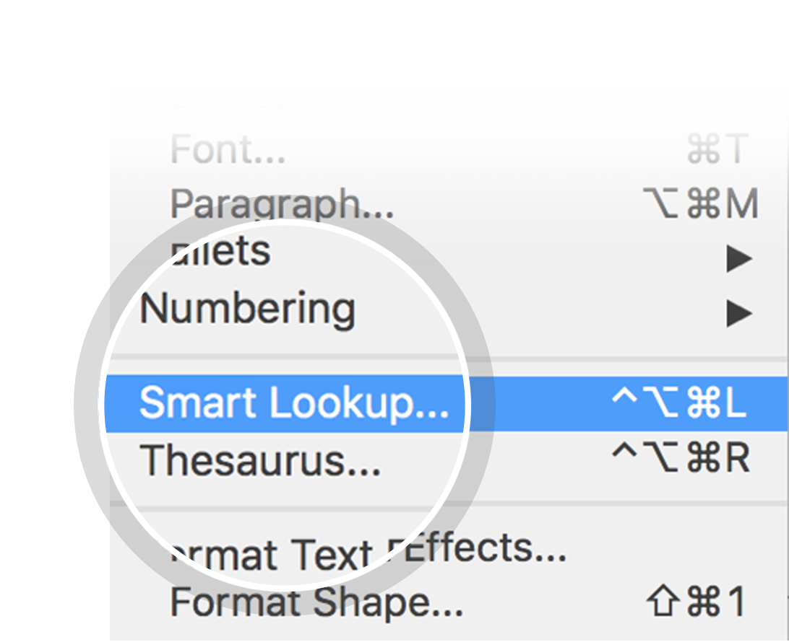
Related topics to research
Ryan Dahl
Joyent
JavaScript library
JSGI
Use Smart Lookup to learn more
1
Highlight one of the related topics
Right-click on the topic
Choose "Smart Lookup"
2
3

Slide 4

History

Slide 5
how was born NodeJS
Node born from the JavaScript V8 write by GOOGLE. (Super Faster interpretation language)
It was created by Ryan Dahl in 2009 and its evolution is sponsored by the company Joyent, which also has a contract with Dahl on staff
Notes:
En lenguajes como Java™ y PHP, cada conexión genera un nuevo hilo que potencialmente viene acompañado de 2 MB de memoria.
En lugar de generar un nuevo hilo de OS para cada conexión (y de asignarle la memoria acompañante), cada conexión dispara una ejecución de evento dentro del proceso del motor de Node. Node también afirma que nunca se quedará en punto muerto, porque no se permiten bloqueos y porque no se bloquea directamente para llamados E/S. Node afirma que un servidor que lo ejecute puede soportar decenas de miles de conexiones concurrentes.

Slide 6
Why use Node.js?
Node.js makes building scalable network programs easy. Some of its advantages include:
It is generally fast
It almost never blocks
It offers a unified programming language and data type
Everything is asynchronous
It yields great concurrency

Slide 7
What are the features of Node.js?
Node.js is a single-threaded but highly scalable system that utilizes JavaScript as its scripting language. It uses asynchronous, event-driven I/O instead of separate processes or threads. It is able to achieve high output via single-threaded event loop and non-blocking I/O.

Slide 8
Why is Node.js Single-threaded?
Node.js is single-threaded for async processing. By doing async processing on a single-thread under typical web loads, more performance and scalability can be achieved as opposed to the typical thread-based implementation.

Slide 9
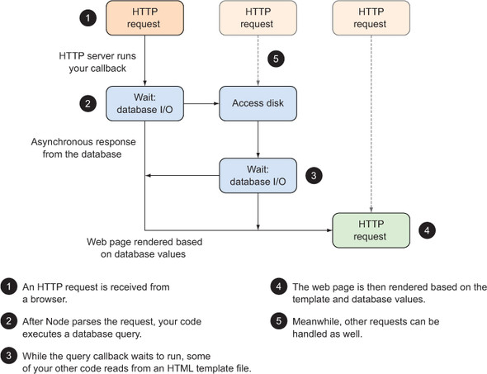

Slide 10
What is not Nodejs?
Is not a server host (Apache, Tomcat, IIS)
You can add modules inside the node.(SSL, Dynamic Pages )
NodeJS Contains hundreds of modules.
Notes:
En lenguajes como Java™ y PHP, cada conexión genera un nuevo hilo que potencialmente viene acompañado de 2 MB de memoria.
En lugar de generar un nuevo hilo de OS para cada conexión (y de asignarle la memoria acompañante), cada conexión dispara una ejecución de evento dentro del proceso del motor de Node. Node también afirma que nunca se quedará en punto muerto, porque no se permiten bloqueos y porque no se bloquea directamente para llamados E/S. Node afirma que un servidor que lo ejecute puede soportar decenas de miles de conexiones concurrentes.

Slide 11
Name the types of API functions in Node.js.
There are two types of functions in Node.js.:
Blocking functions - In a blocking operation, all other code is blocked from executing until an I/O event that is being waited on occurs. Blocking functions execute synchronously
For example: const fs = require('fs'); const data = fs.readFileSync('/file.md'); // blocks here until file is read console.log(data); // moreWork(); will run after console.log
The second line of code blocks the execution of additional JavaScript until the entire file is read. moreWork () will only be called after Console.log
Non-blocking functions - In a non-blocking operation, multiple I/O calls can be performed without the execution of the program being halted. Non-blocking functions execute asynchronously.

Slide 12
For example:
const fs = require('fs'); fs.readFile('/file.md', (err, data) => { if (err) throw err; console.log(data); }); // moreWork(); will run before console.log
Since fs.readFile () is non-blocking, moreWork () does not have to wait for the file read to complete before being called. This allows for higher throughput.

Slide 13
What is the difference between Node.js and Ajax?
Node.js and Ajax (Asynchronous JavaScript and XML) are the advanced implementation of JavaScript. They all serve completely different purposes.
Ajax is primarily designed for dynamically updating a particular section of a page’s content, without having to update the entire page.
Node.js is used for developing client-server applications.

Slide 14
INSTALLING NODEJS
You can install from
https://nodejs.org

Slide 15
Data Types
String
Number
Boolean
Undefined
Null
RegExp

Slide 16
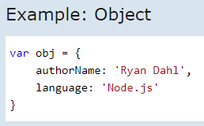
Loose Typing : JavaScript in Node.js supports loose typing like the browser's JavaScript. Use var keyword to declare a variable of any type.
Object Literal : Object literal syntax is same as browser's JavaScript.

Slide 17
Buffer: Node.js includes an additional data type called Buffer (not available in browser's JavaScript). Buffer is mainly used to store binary data, while reading from a file or receiving packets over the network.
process object: Each Node.js script runs in a process. It includes process object to get all the information about the current process of Node.js application.
The following example shows how to get process information in REPL using process object
Defaults to local: Node's JavaScript is different from browser's JavaScript when it comes to global scope. In the browser's JavaScript, variables declared without var keyword become global. In Node.js, everything becomes local by default.
Access Global Scope: In a browser, global scope is the window object. In Node.js, global object represents the global scope.
To add something in global scope, you need to export it using export or module.export. The same way, import modules/object using require() function to access it from the global scope.

Slide 18
Node.js Console - REPL
Node.js comes with virtual environment called REPL (aka Node shell). REPL stands for Read-Eval-Print-Loop. It is a quick and easy way to test simple Node.js/JavaScript code.
To launch the REPL (Node shell), open command prompt (in Windows) or terminal (in Mac or UNIX/Linux) and type node as shown below. It will change the prompt to > in Windows and MAC.

Slide 19
Node.js EventEmitter
Node.js allows us to create and handle custom events easily by using events module. Event module includes EventEmitter class which can be used to raise and handle custom events.
http://www.tutorialsteacher.com/nodejs/nodejs-eventemitter

Slide 20
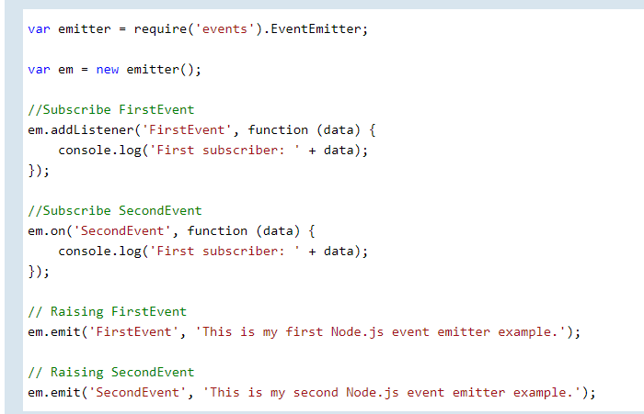

Slide 21
What npm is?
npm is a package manager for the JavaScript programming language. It is the default package manager for the JavaScript runtime environment Node.js. It consists of a command line client, also called npm, and an online database of public and paid-for private packages, called the npm registry.

Slide 22

Most important nodes libraries
https://colorlib.com/wp/npm-packages-node-js/
https://www.creativebloq.com/features/20-nodejs-modules-you-need-to-know/2

Slide 23
Defects (How can you avoid callback hells?)
There are lots of ways to solve the issue of callback hells:
modularization: break callbacks into independent functions
use a control flow library, like async
use generators with Promises
use async/await (note that it is only available in the latest v7 release and not in the LTS version

